Slide 1
Finding a Night Club Location in new YoRk
In the time of COVID using Data Science Techniques

Slide 2
Motivation
Finding a location for a New Night club in New York City is the goal
An optimal location would be one where other highly rated night clubs are located
The assumption is club patrons will club hop switching from one club to another. (Even when there is a cover charge.)
If a neighborhood is a hot spot for clubbing it will have numerous night clubs. Such a neighborhood is already attracting patrons so locating a club there would be beneficial.
A new night spot which is in proximity will attract the curious. Walking distance and short taxi rides

Slide 3
considerations
Many clubs are closed in New York City because of COVID-19
Data is limited through the FourSquare API
There is less traffic and fewer patrons
However, it is even more critical to find a location with clubs still open that are still rated highly.

Slide 4
Data Acquisition and Cleaning
New York neighborhood data from Coursera assignment:
https://geo.nyu.edu/catalog/nyu_2451_34572
306 entries having latitude and longitude of geographical centers of neighborhoods
New York boundary data from geo json file:
https://github.com/veltman/snd3/blob/master/data/nyc-neighborhoods.geo.json
188 entries having the geographical boundaries of neighborhoods as polygons
Some neighborhoods were combined into single polygons
Foursquare API used to get Night Clubs based on distance from geographical centers of neighborhoods

Slide 5
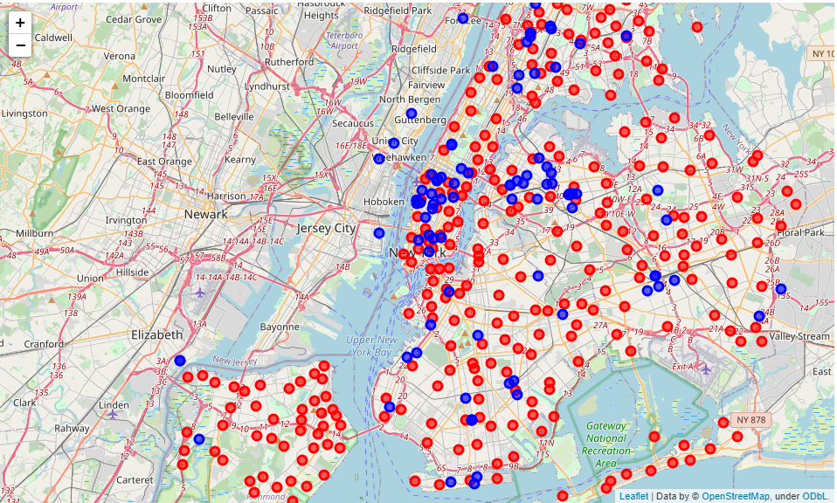
Club Locations and Neighborhood centers

Slide 6
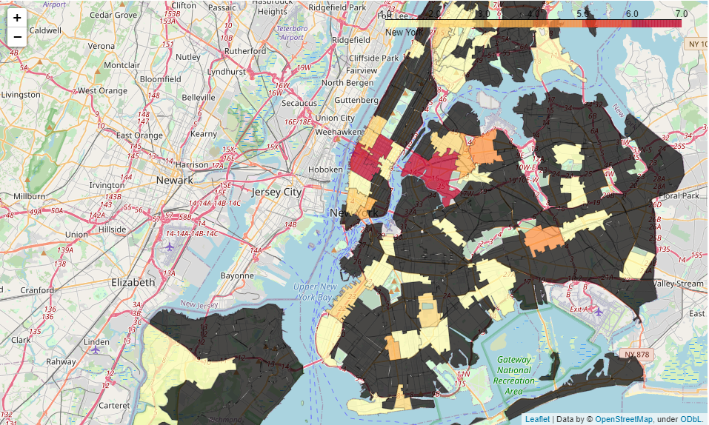
Binning Clubs Geographically

Slide 7
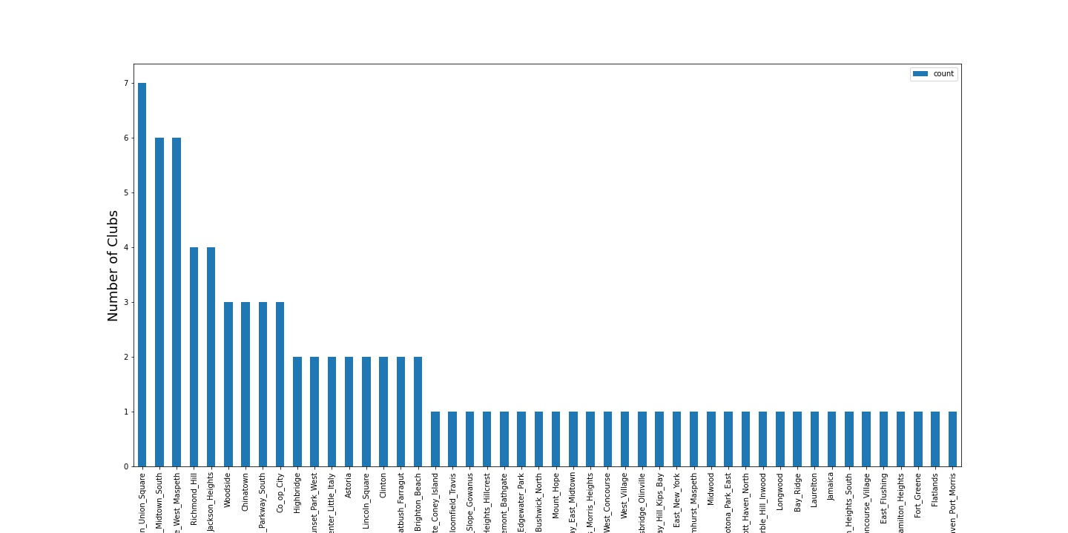
Ranking the Top Neighborhoods

Slide 8
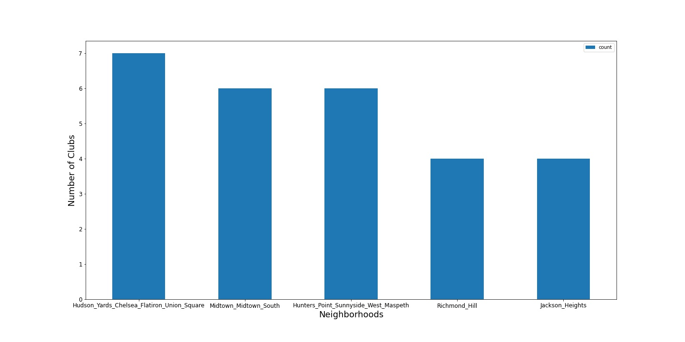
Five Neighborhoods with the most clubs

Slide 9
Limitations Because of Covid-19
Many clubs in New York at this time are closed
Many clubs didn’t have foursquare IDs to pull additional information
Rating information was not available on all Night Clubs because of the closing
Any club that did not have a rating was assigned a penalty of -1.
Any areas with many closed clubs would have a large penalty
The assumption is it’s better to open a club any club in an area with other open clubs instead of an area with no clubs.
That is some night life is better than no night life

Slide 10
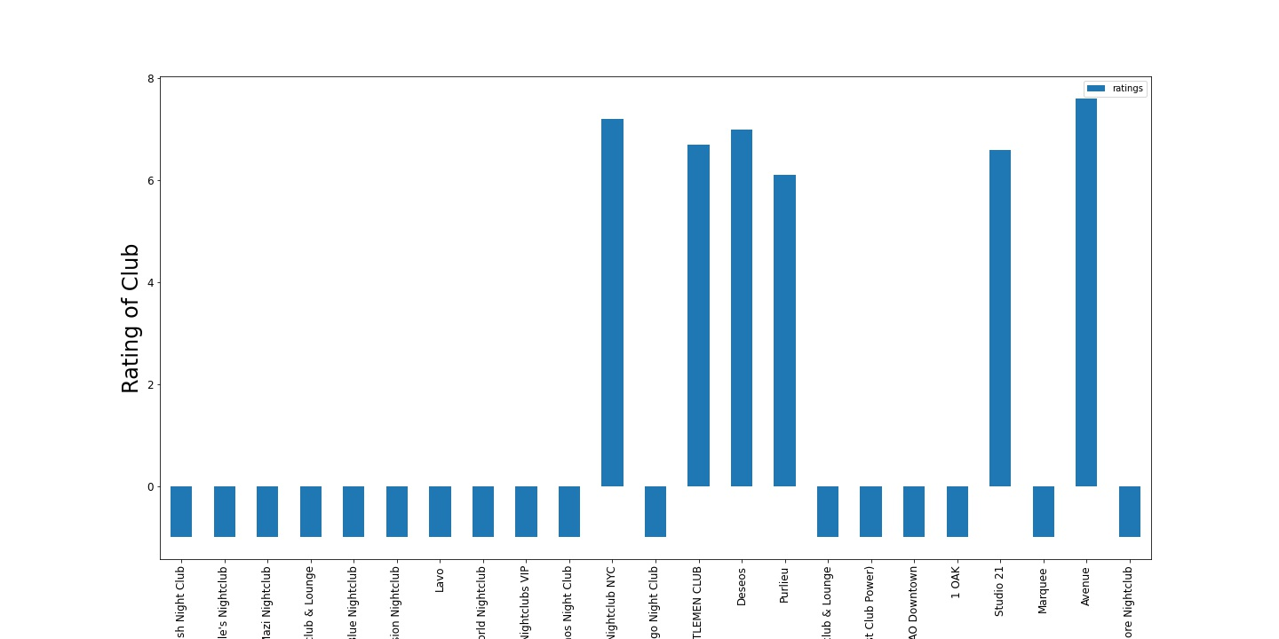
Adding the Average Club Rating

Slide 11
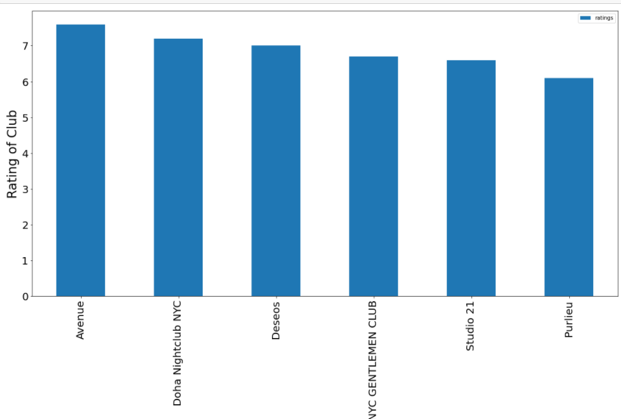
Plotting the Only clubs that have a Rating

Slide 12
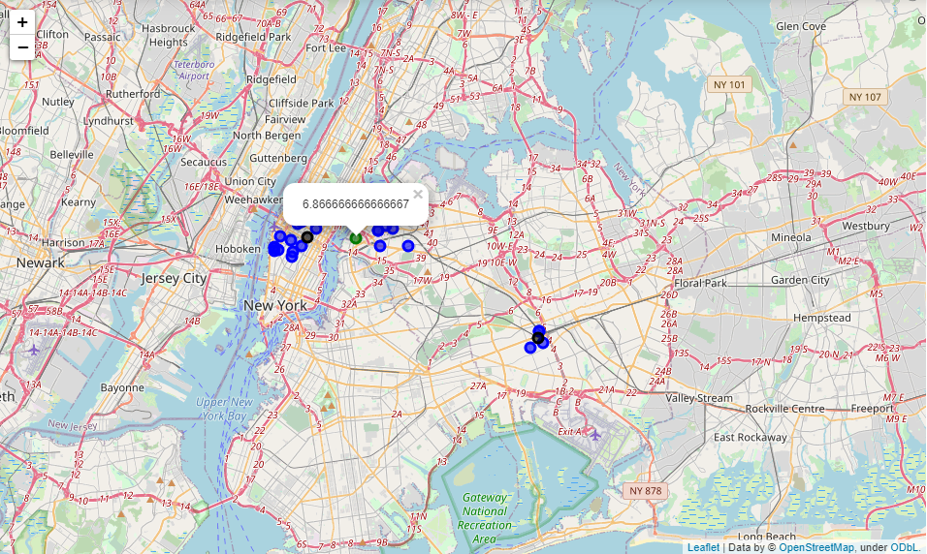
Clustering by Location and Rating
K-means Clustering
3 centroids

Slide 13
Picking the best Neighborhood
Using K-means clustering
Three distinct clusters were used
The average rating produced for each cluster was compared
Only 1 cluster had a positive rating
It also contained the most clubs with positive ratings
The neighborhood seemed more resilient to a downturn in the economy due to covid. More open clubs mean that location is fairing better.

Slide 14
Conclusion and Future Directions
The centroid of the cluster with the highest average rating is located within the bounds of 'Hunters_Point_Sunnyside_West_Maspeth’ boundary
The closest Neighborhood center to the cluster centroid is “Hunters Point”
These methods are in agreement so the neighborhood with clubs that have the highest average rating is “Hunters Point”
The analysis could be run again after the covid crisis ends. Many venues are currently closed, but this neighborhood seems to have the highest resiliency with clubs still open.
This location may lead the recovery of the night club scene.

